Slide 1
Reusable maps and graphs from ECDC Communicable Disease Threats Report
Week 16, 2024
You are encouraged to reuse our maps and graphs for your own purposes and are free to translate them, provided the content is not altered and the source is acknowledged.

Slide 2
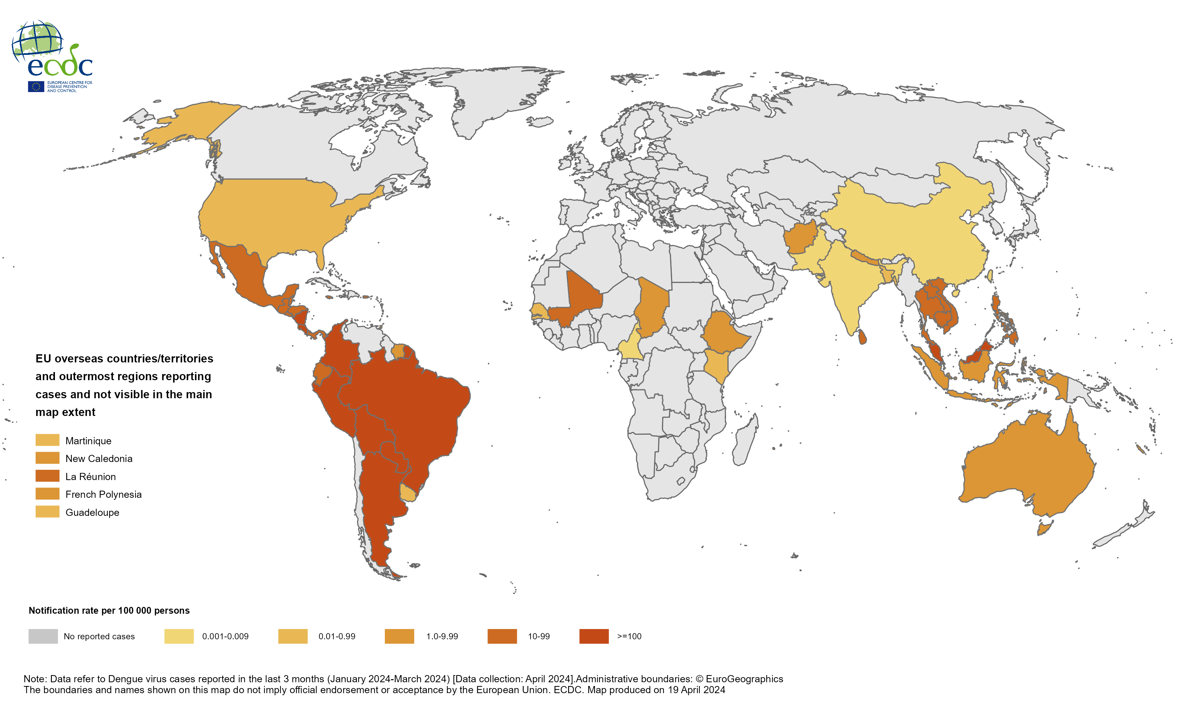
Three-month dengue virus disease case notification rate per 100 000 population, January—March 2024

Slide 3
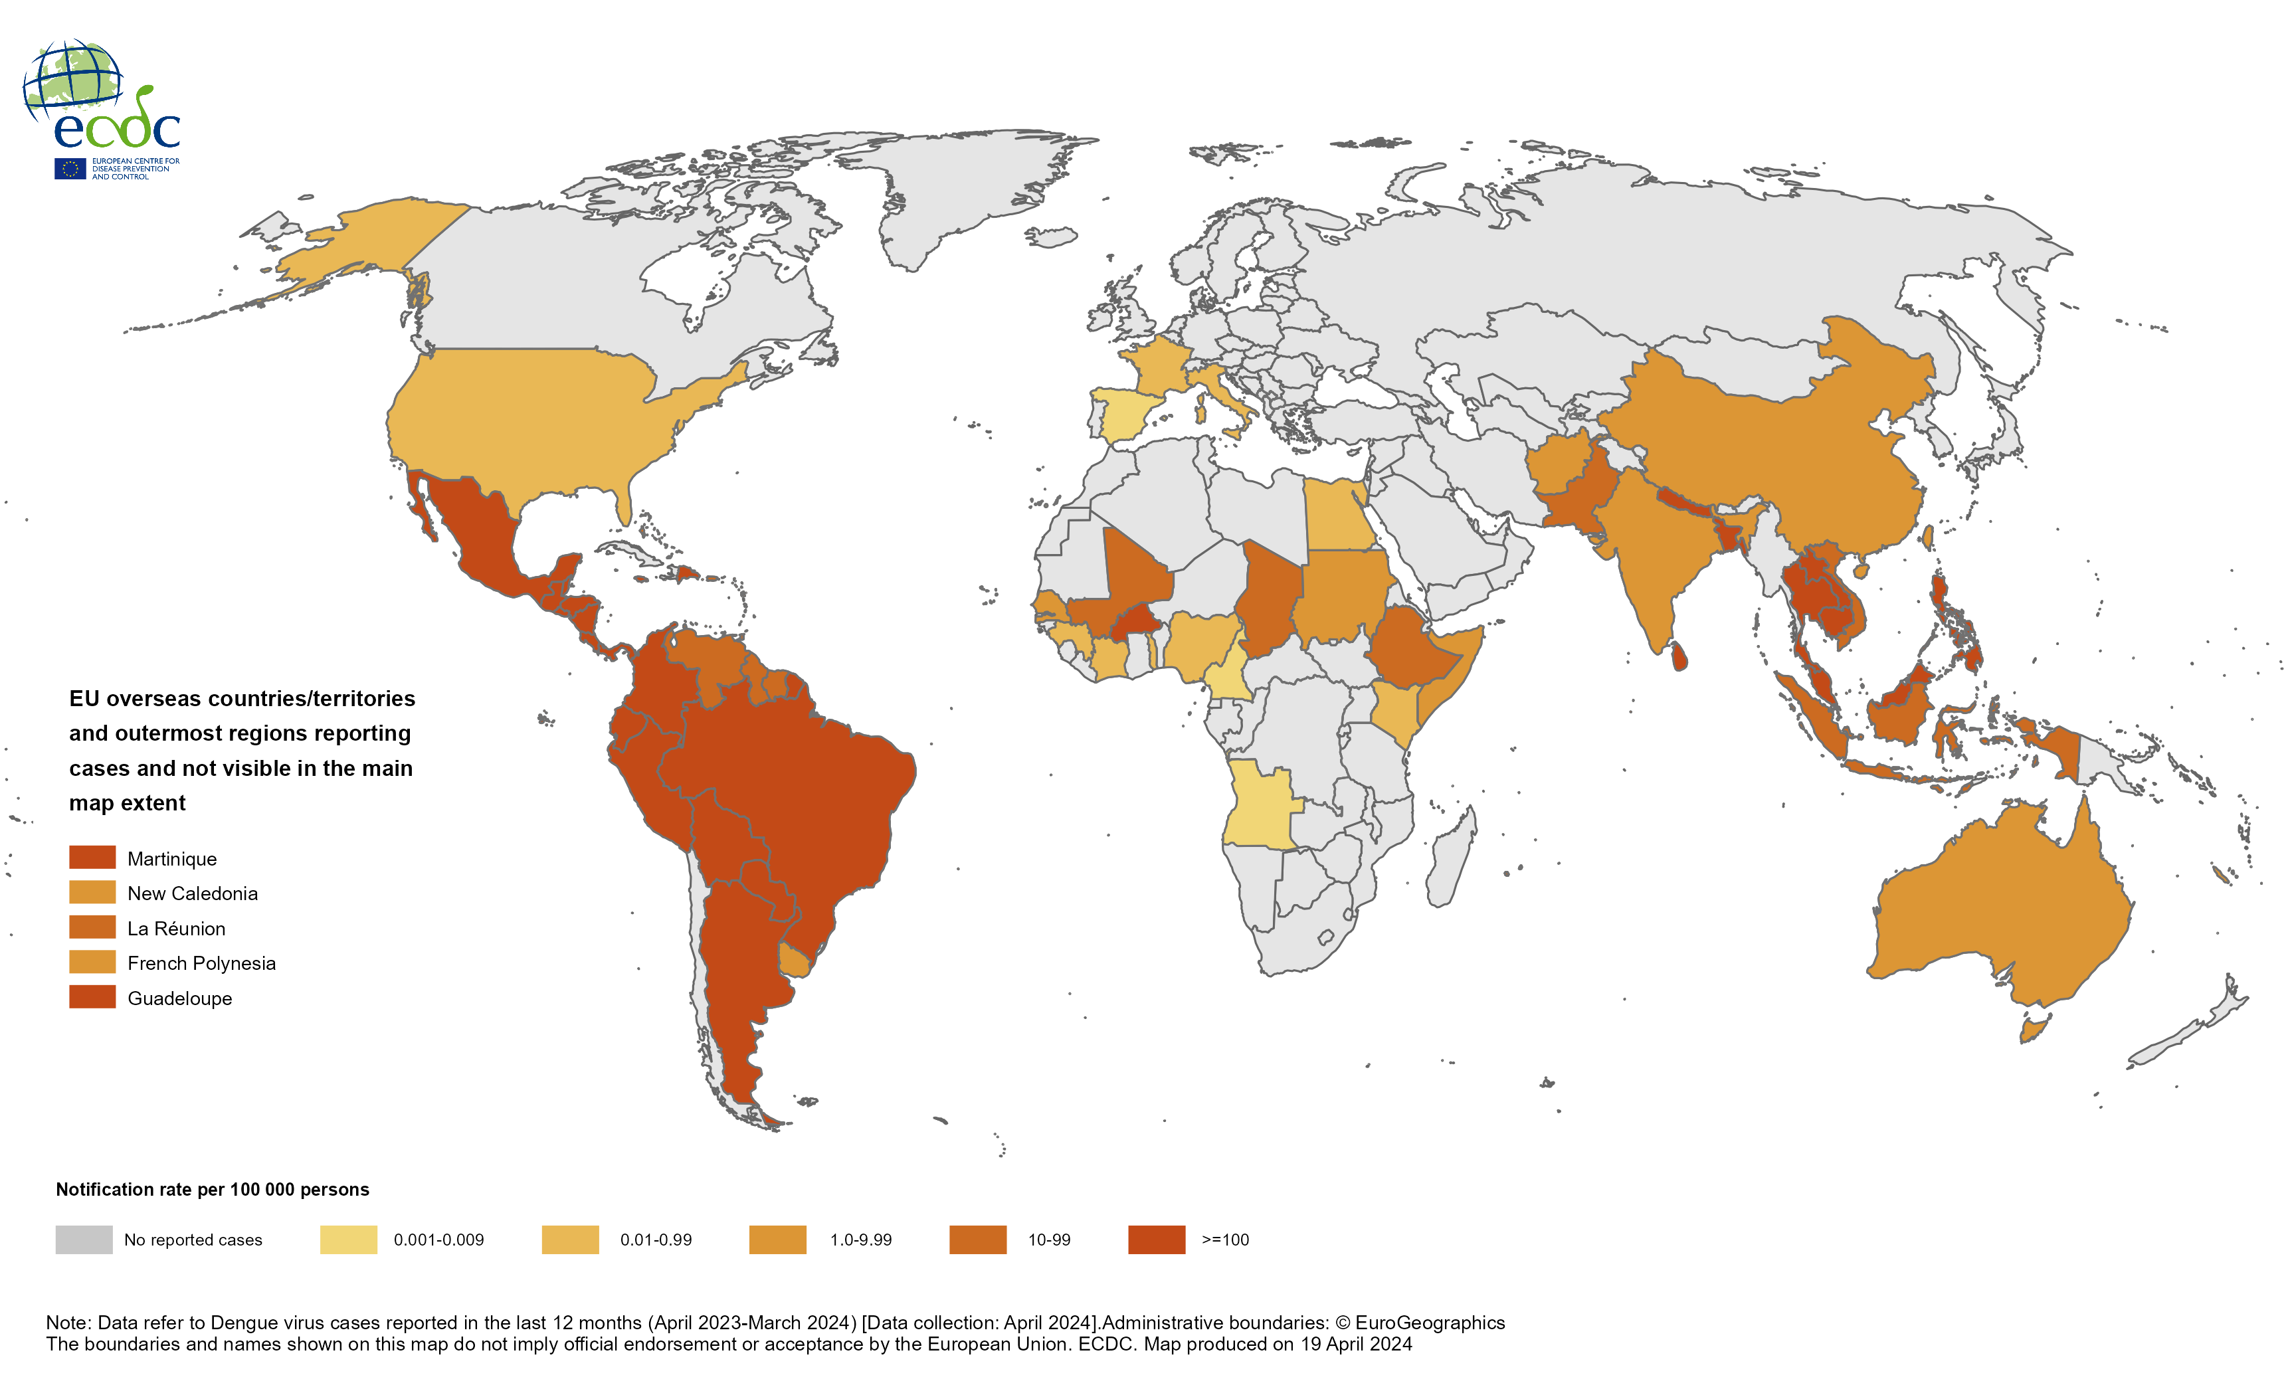
Countries/territories reporting dengue cases since April 2023, and as of March 2024

Slide 4
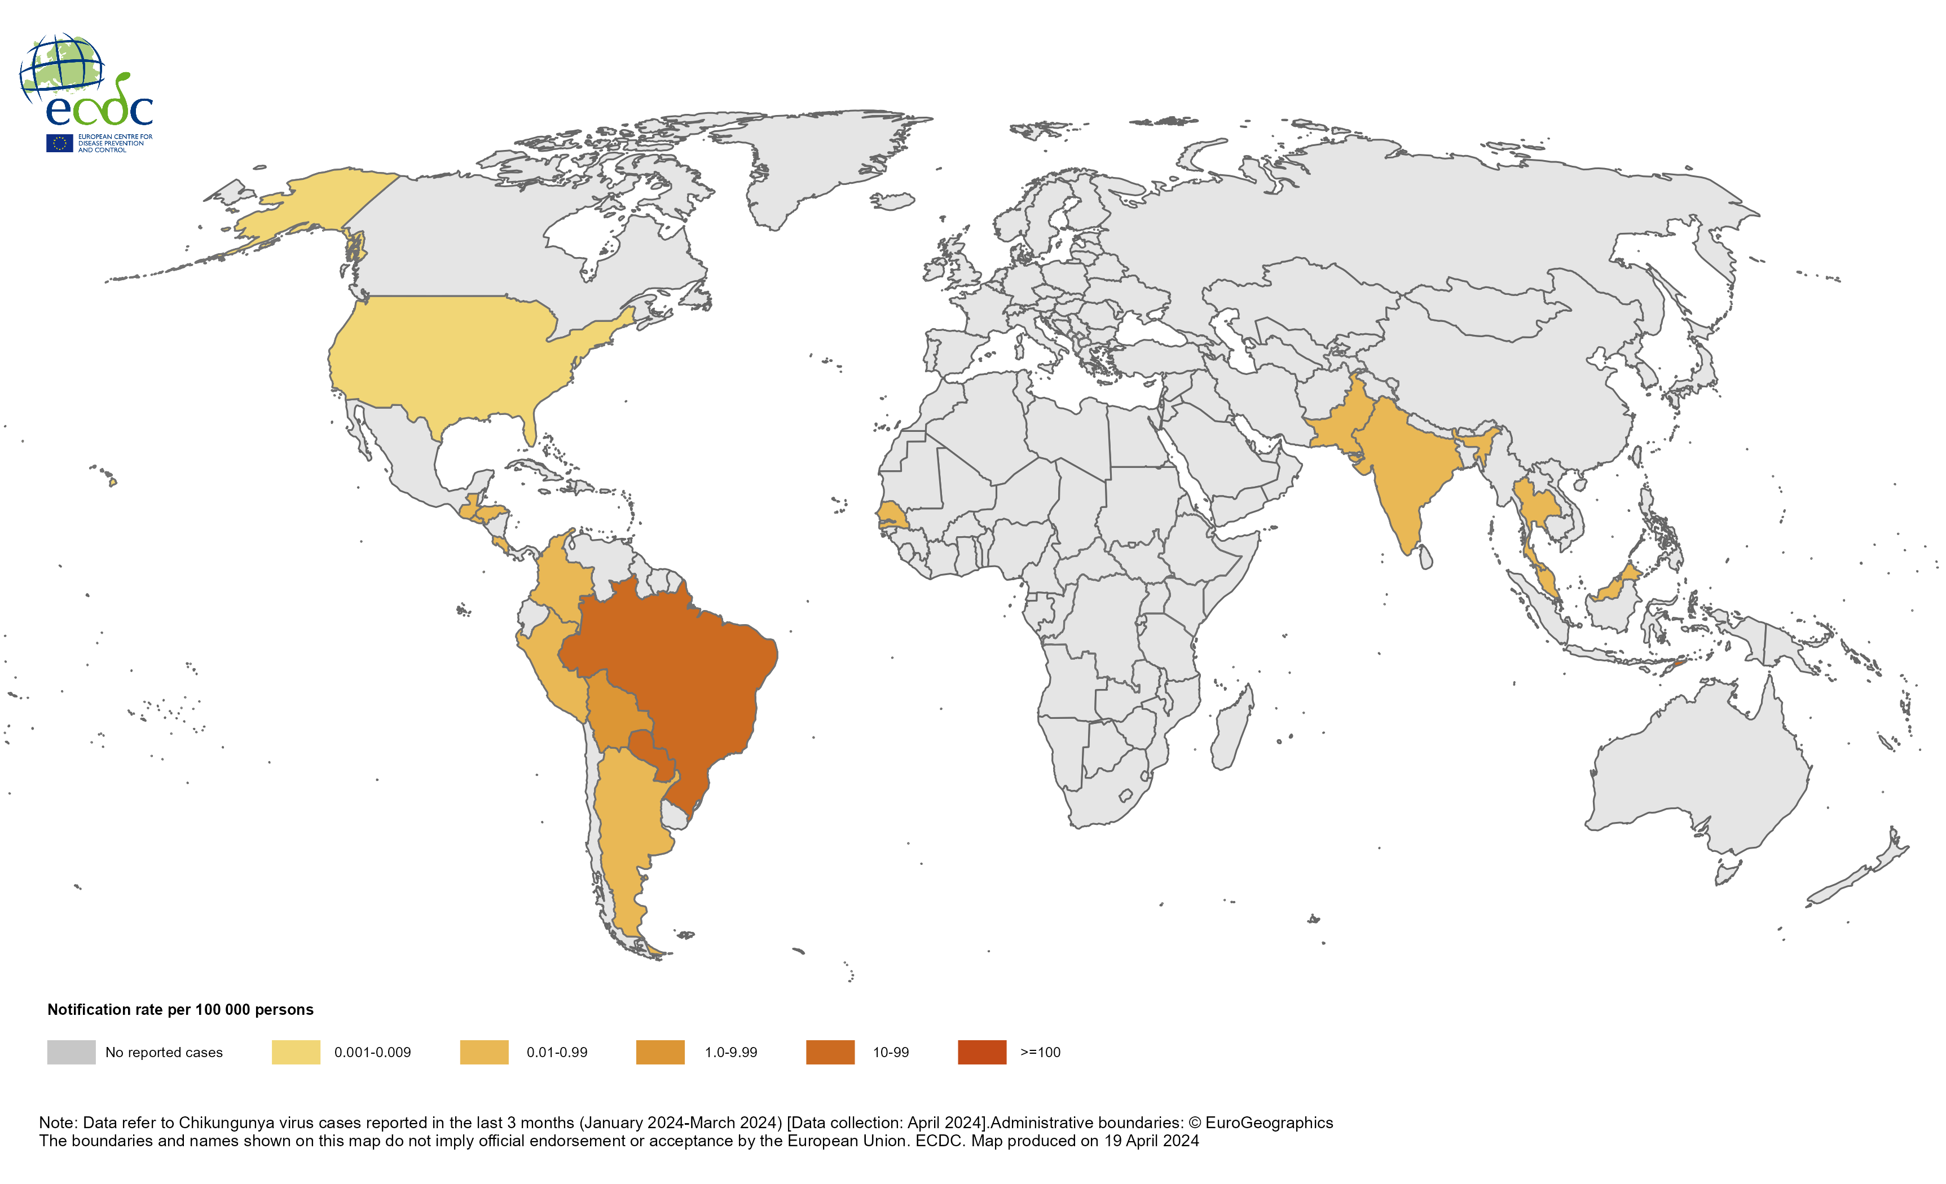
Three-month Chikungunya virus disease case notification rate per 100 000 population, January—March 2024

Slide 5
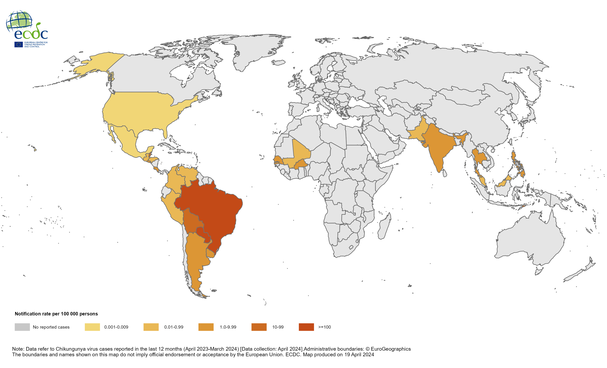
Countries/territories reporting Chikungunya cases since April 2023, and as of March 2024

